Slide 1
10 Steps to Becoming a Tidyverse Contributor
Nic Crane

Slide 2


Hello!
Nic Crane
@nic_crane

Slide 3
Who here…
Knows what the Tidyverse is?
Tweets about R?
Blogs about R?
Has written an R function?
Uses git?
Has written an R package?
Has a package on CRAN?
Has contributed to a Tidyverse package?

Slide 4
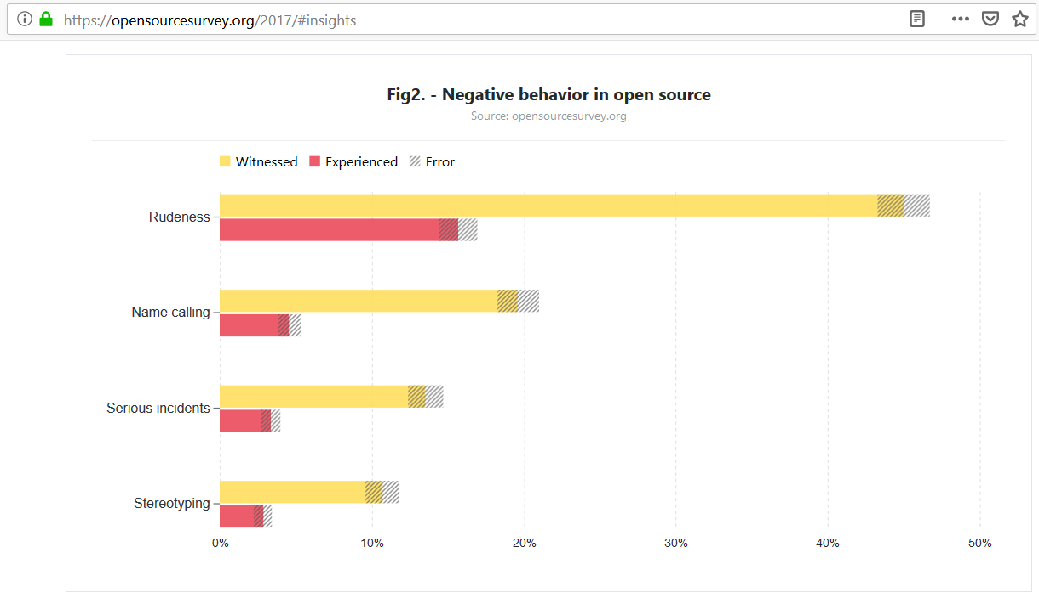

Slide 5
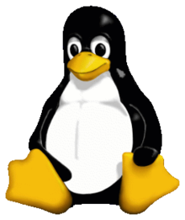

Culture is Changing in Open Source
Notes:
Stack Overflow: In 2016, a research paper showed that 5.8 per cent of active contributors are women even through 20 per cent of visitors are women. Stack Overflow actively admitted that the community there could be hostile to women, people of color, and marginalized groups, and has promised to do better. In August, this they released their new code of conduct which explicitly tackles aggressive behaviour.
In September, Linus Torvalds, the creator of Linux, issued an apology for years of aggressive behaviour and promised to get help whilst also releasing a new code of conduct.

Slide 6
How Does R
Compare?
2017: “The R community is one of R’s best features”
2012: RLadies Founded
2015: R Forwards set up
2011: rOpenSci Founded
2015: R Consortium established
2016: “The R community is awesome (and fast)”
2017: RStudio Community Forums goes live

Slide 7
Why Should You Contribute?
GITHUB SURVEY 2017
“Half of contributors say that their open source work was somewhat or very important in getting their current role.”
“Open source work helps people build their professional reputation.”
“Improving contributor representation can help create a more representative tech sector overall.”

Slide 8
Why Should You Contribute?
MY PERSONAL REASONS
Improve code knowledge
Interact with the community
Overcome Lessen imposter syndrome

Slide 9
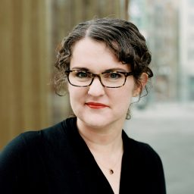
When I started my transition into data science, I said yes to pretty much every opportunity that came my way, even if it felt slightly beyond my skill set or experience level...I said yes to many of these things when it felt like I wasn’t sure if I was ready.
—Julia Silge
Interview with And Comfort (October 2018)

Slide 10

Not always easy for beginners. Helps to have a team that will onboard. Give beginner level work. Mentorship. Pick projects that are welcoming.
—Gabriela de Queiroz [summarised tweet]
Grace Hopper Celebration of Women in Computing (2018)

Slide 11
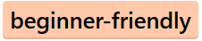


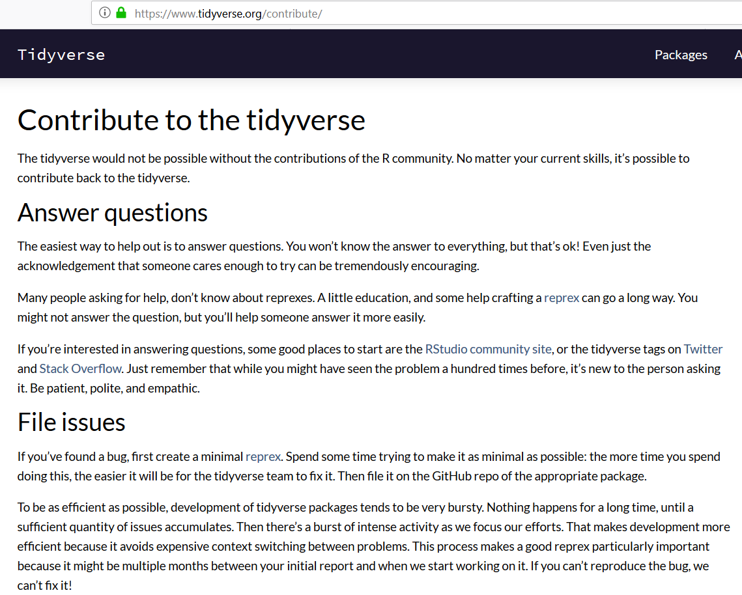

The tidyverse is a great place to get involved

Slide 12
Step 1 Decide How to Contribute
Identifying issues
Documentation
Helping people out on Twitter and forums
Blogging
Code

Slide 13
Step 2 Learn!
R functions
git (clone, commit, push)
Building R packages (basics)
GitHub – making a pull request

Slide 14
Step 3 Find an Issue
Notes:
The next step is finding an issue to work on. Luckily, many issues are tagged on GitHub with “beginner friendly”, “help wanted”, or “good first issue” to help point you in the right direction.

Slide 15
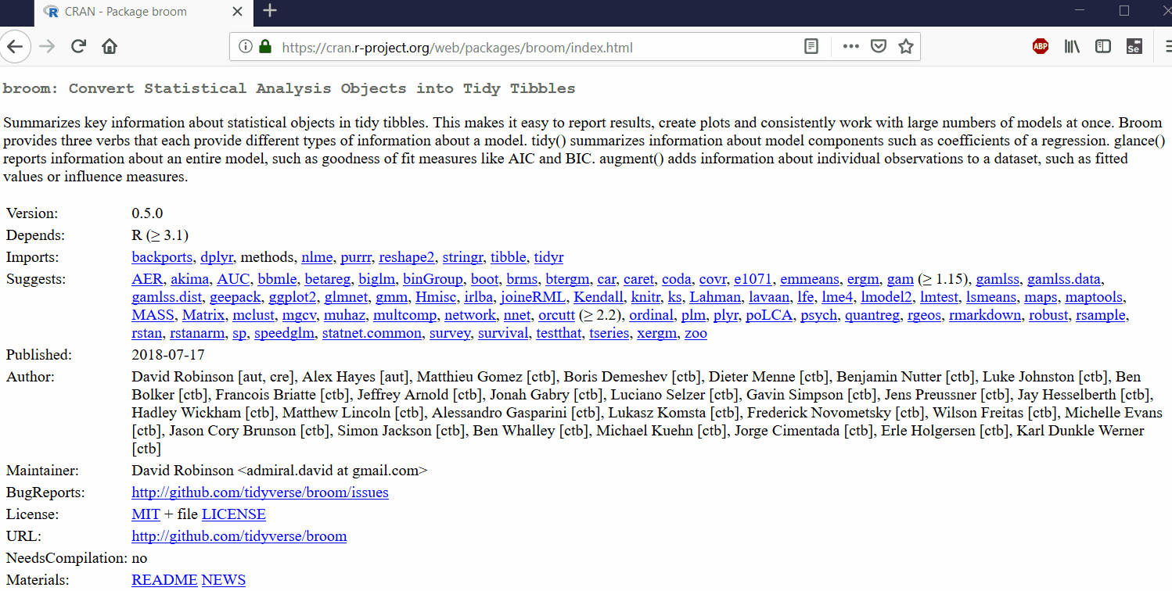
Step 3 Find an Issue
Notes:
In the GIF here, I show how to get from the CRAN page for a package – broom in this case – to a potential issue to work on. I first click on the URL next to “BugReports” to get taken to the GitHub issues page. Next I find a relevant tag – “beginner friendly” in this case. Once I click on the tag, I’m shown all issues with that tag. I then pick one, and read the description to see if it’s something I think would be good to look at getting involved with.

Slide 16
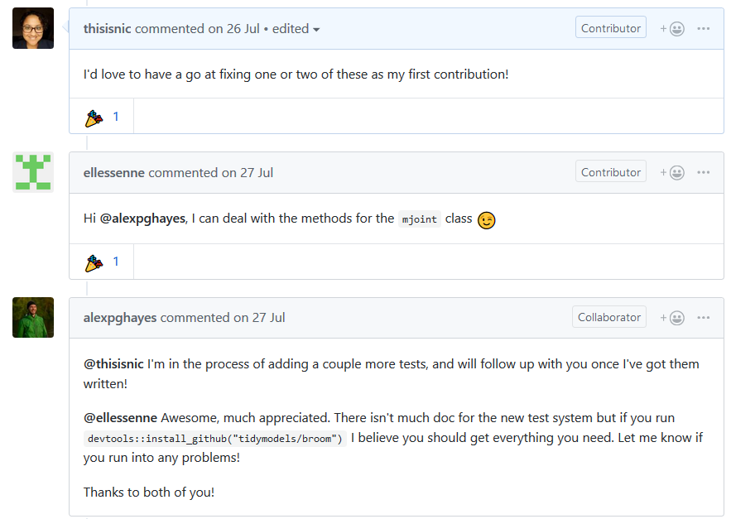
Step 4 Ask if You Can Help
Notes:
You can’t just wade in there and make a start
Don’t want to duplicate work that someone else is doing
Check they actually need help

Slide 17
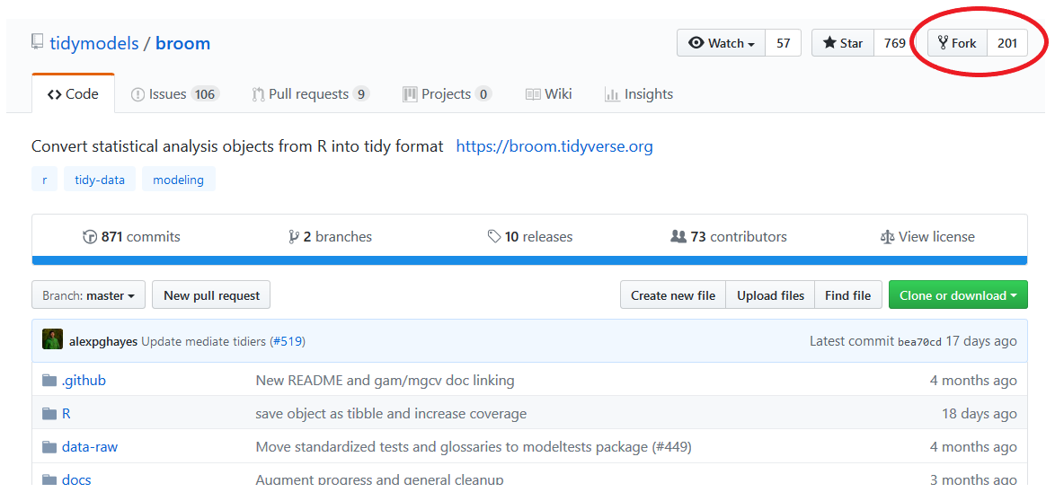
Step 5 Fork the Repo

Slide 18
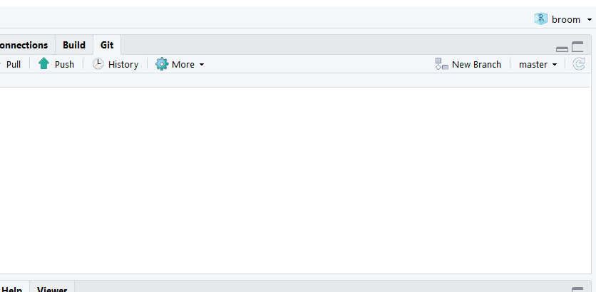
Step 6 Open in RStudio & Make a Branch

Slide 19
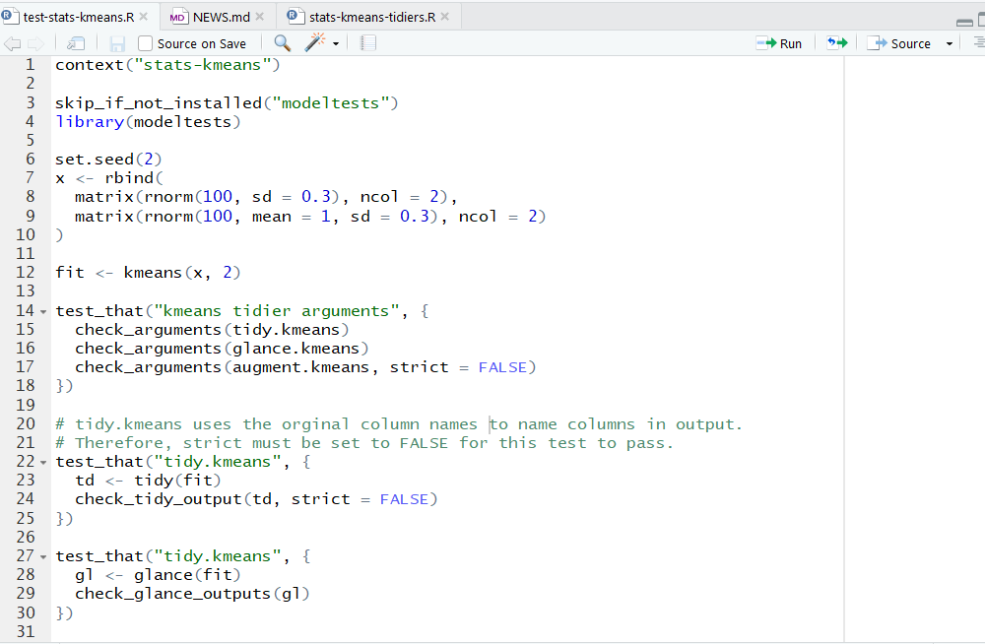
Step 7 Familiarise Yourself with the Code

Slide 20
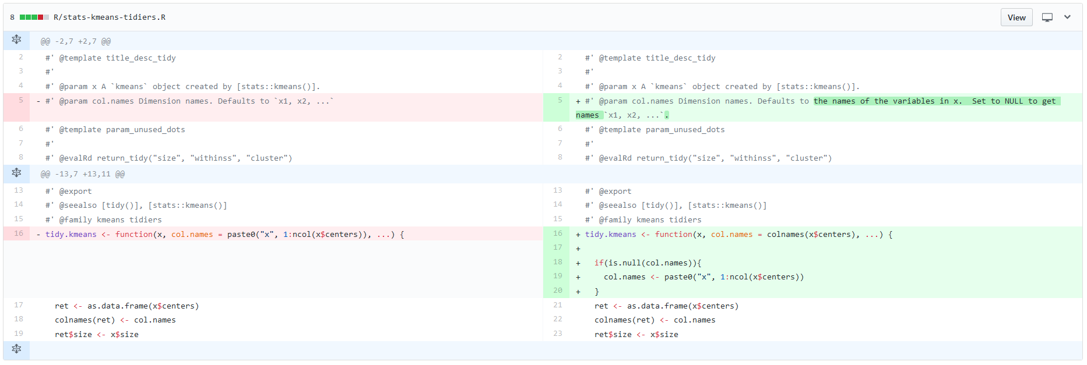
Step 8 Write Code
Notes:
Be succinct, don’t introduce new dependencies

Slide 21
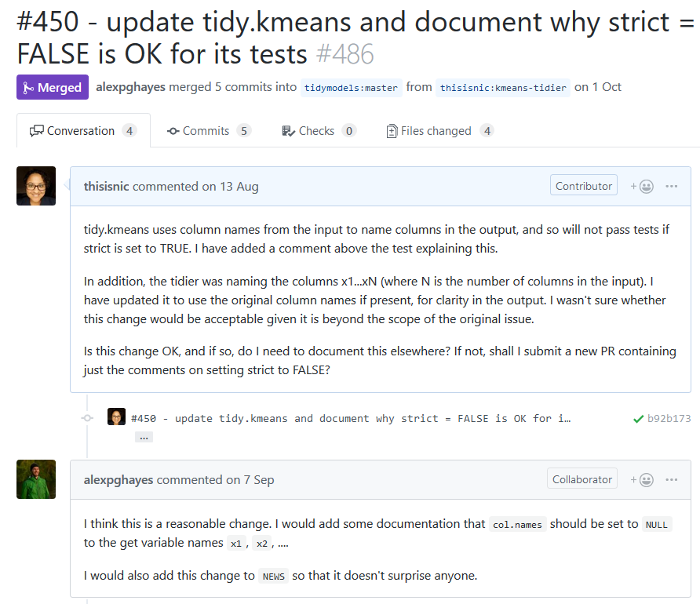
Step 9 Submit PR and Wait
Notes:
Other people have lives, nerd; don’t be impatient! ;)

Slide 22
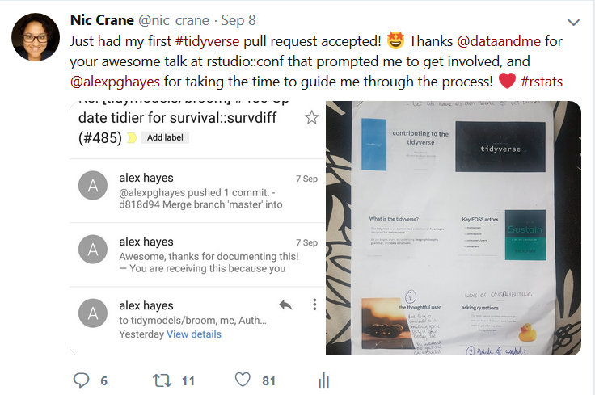
Step 10 Celebrate! Then Encourage Others to Get Involved and Share Your Experience

Slide 23
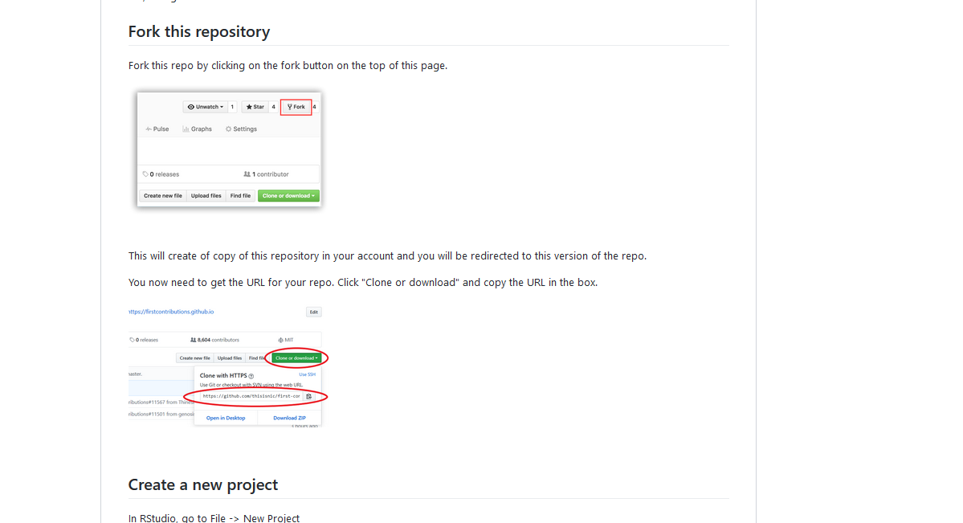
Never Submitted a PR Before? Check out the first contributions repo!
https://github.com/thisisnic/first-contributions

Slide 24
Other ways to get involved
Blogging
Screencasts
Tweets
GitHub gists

Slide 25
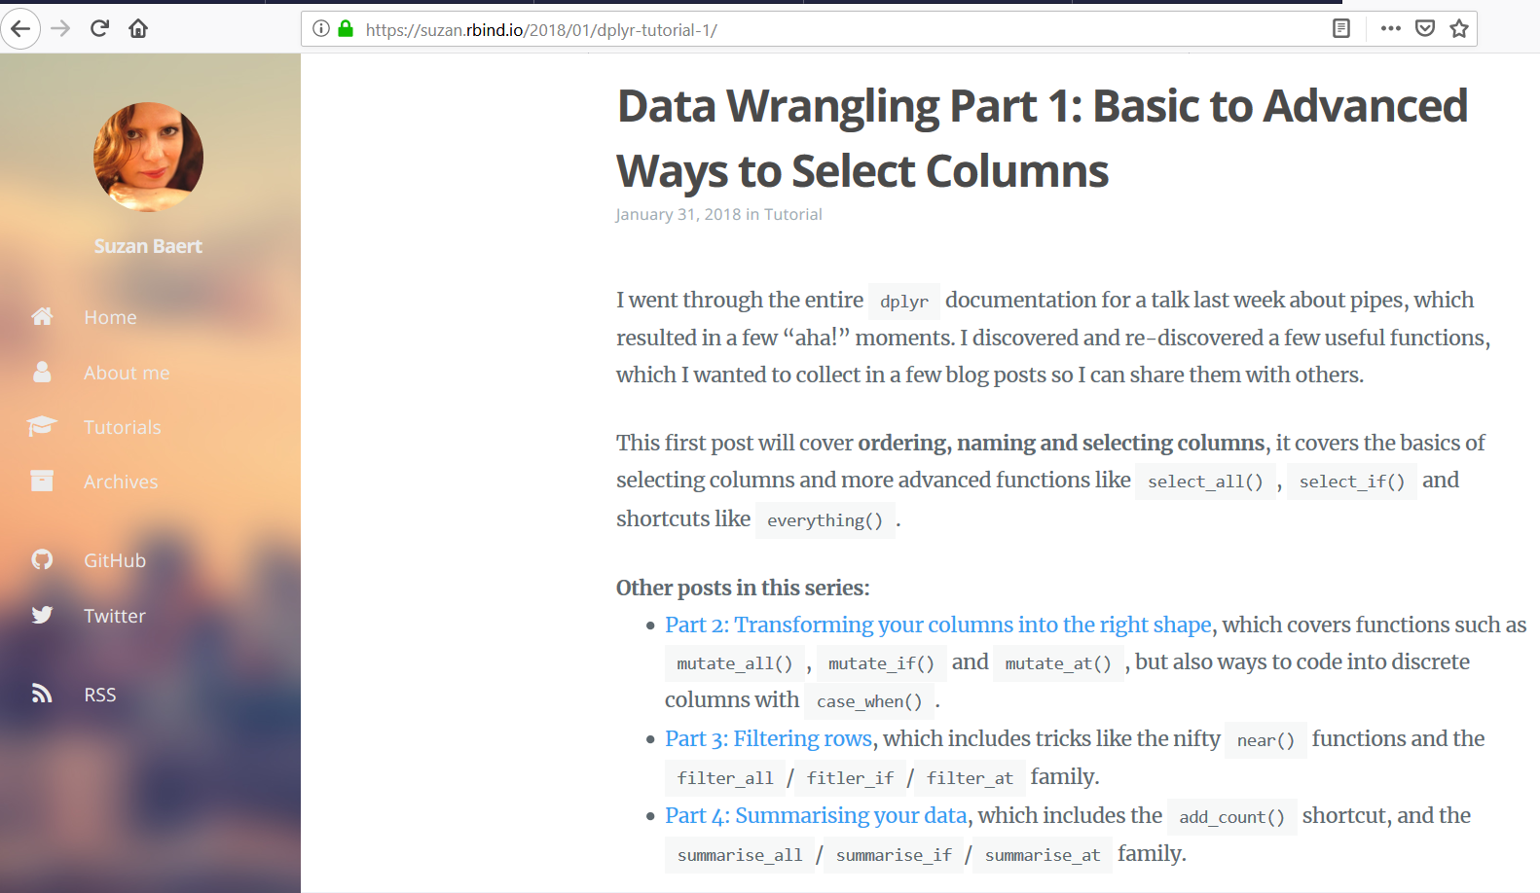
Blogging

Slide 26
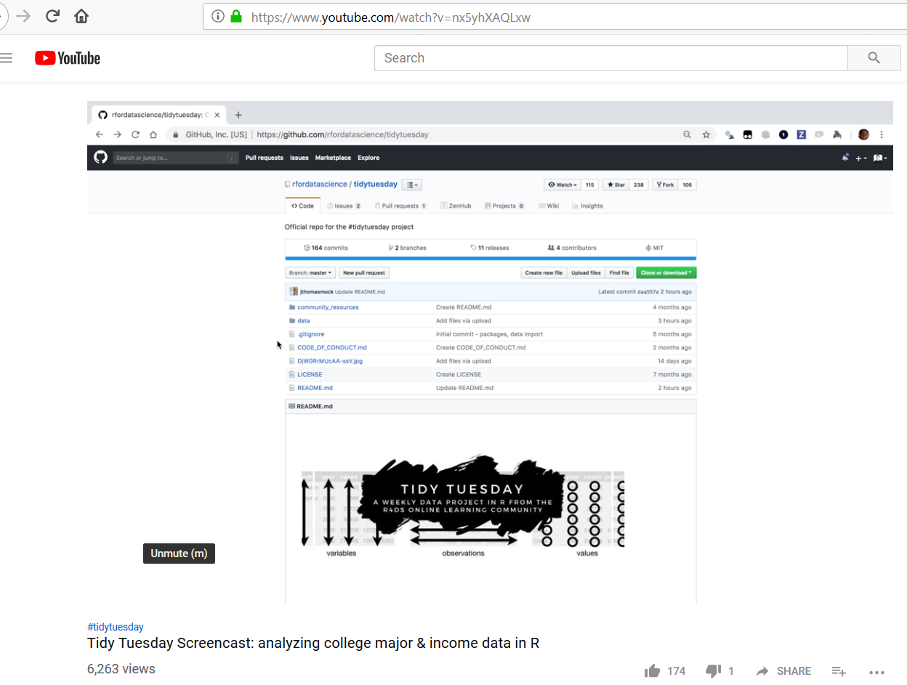
Screencasts

Slide 27
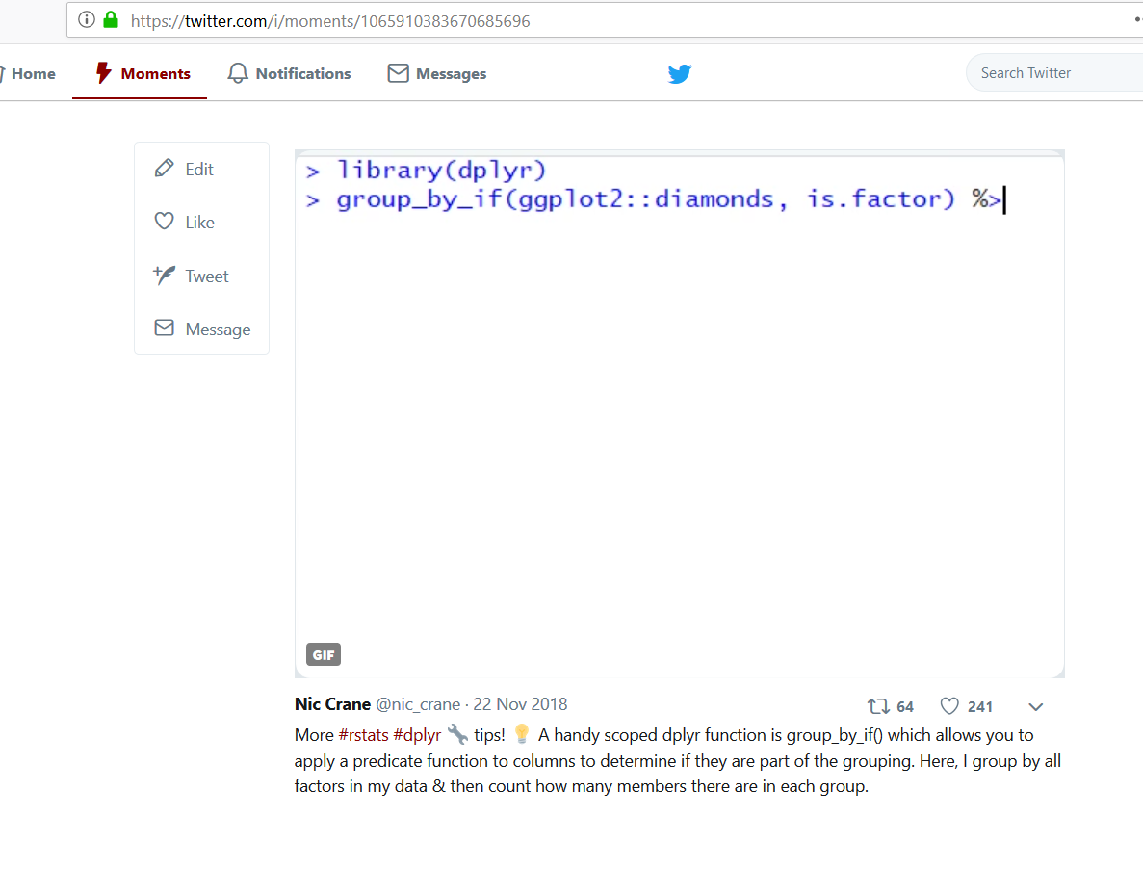
Tweeting

Slide 28
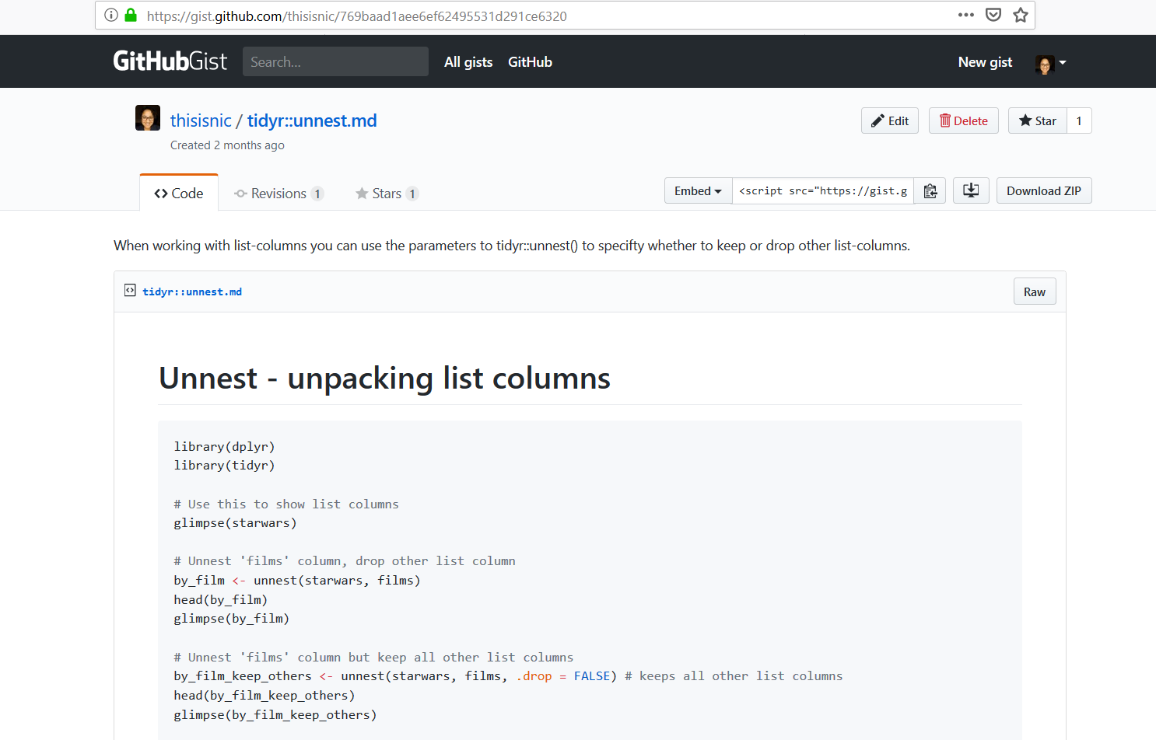
GitHub Gists

Slide 29
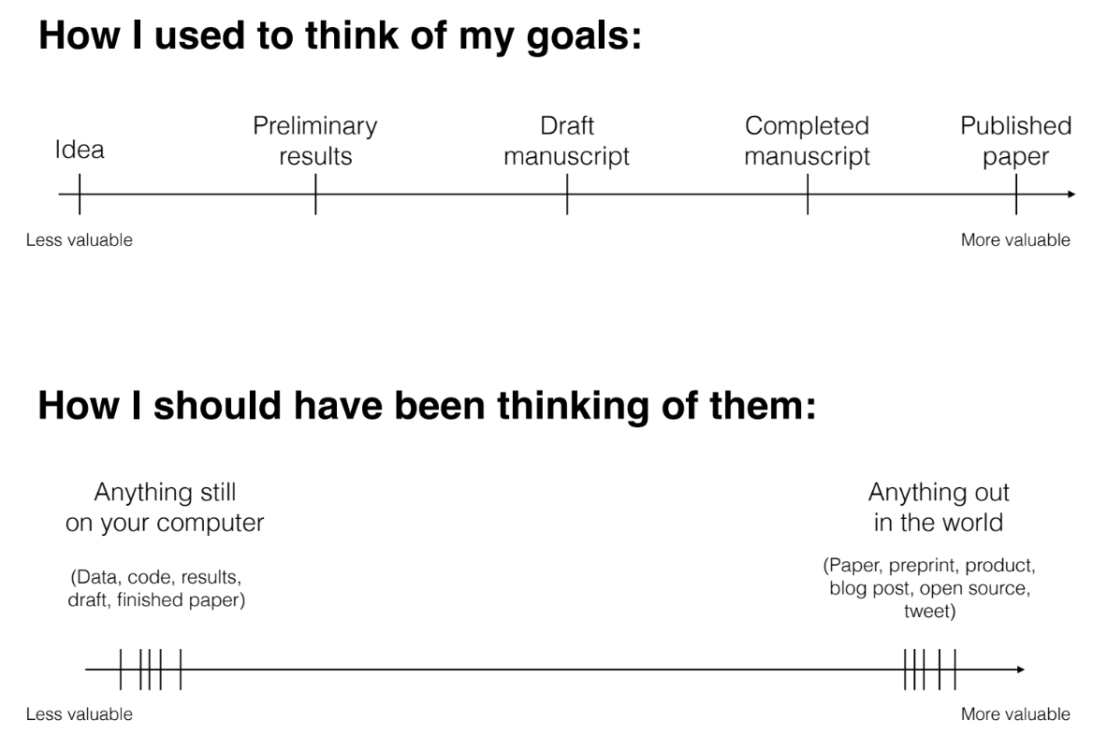
“The unreasonable effectiveness of public work” – David Robinson

Slide 30
Resources
Talk by Mara Averick on contributing:
https://www.rstudio.com/resources/videos/contributing-to-tidyverse-packages/
rOpenSci contributing guide:
https://ropensci.github.io/dev_guide/contributingguide.html
Repo walking through making a pull request:
https://github.com/thisisnic/first-contributions
Guide to contributing code to the tidyverse:
https://www.tidyverse.org/articles/2017/08/contributing/
Talk by David Robinson on public work:
https://resources.rstudio.com/rstudio-conf-2019/the-unreasonable-effectiveness-of-public-work

Slide 31
Thanks! ☺
Nic Crane
@nic_crane

